Slide 1



MEDICAL RECORDS
DEFINATION , TYPES

Slide 2
INTRODUCTION
FIRST MEDICAL RECORD UNIT WAS ESTABLISHED IN 1667 AT ST. BARTHOLOMEW’S HOSPITAL, ENGLAND. FOLLOWED BY PRACTICE OF MAINTAINING PATIENT REGISTER IN PENNSYLVANIA HOSPITAL, USA IN 1792.
IDEA OF PROPER MEDICAL RECORDS IN FORM OF STANDARDIZED INPATIENTS RECORDS CAME IN USA FROM THE AMERICAN COLLEGE OF PHYSICIANS AND AMERICAN COLLEGE OF SURGEONS IN THE LAST QUARTER OF THE 20TH CENTURY.
IN INDIA BHORE COMMITTEE (1946) FIRST STRESSED THE IMPORTANCE OF KEEPING MEDICAL RECORDS.
REITERATED BY MUDALIAR COMMITTEE IN 1962. SUBSEQUENTLY, HEALTH AND HOSPITAL REVIEW COMMITTEE (JAIN COMMITTEE AND RAO COMMITTEE) HIGHLIGHTED POOR STATE OF MEDICAL RECORDS AND RECOMMENDED THE ESTABLISHMENT OF A PROPER MEDICAL RECORDS SECTION IN EACH HOSPITAL.
WITH TECHNICAL ADVANCEMENT, COMPUTERS ARE EXTENSIVELY USED FOR RECORD GENERATION, ANALYSIS AND RETRIEVAL. MICROFILMING HAS ALSO BEEN INTRODUCED FOR EASY STORAGE AND RETRIEVAL.

Slide 3
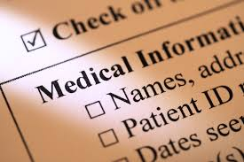
WHAT IS MEDICAL RECORDS?
The medical record can be defined as an orderly written docum,ent encompassing the patient’s health history, physical examination,. Findings , laboratory reports, treatment and surgical procedure reports and hospital course. When complete, the record should contain sufficient data to justify investigations, diagnosis, treatment , length of stay, results of care and future course of action .
Medical record is a legal document providing a chronicle of a patient’s medical history and care. Physicians , nurse practitioners and other members of health care team may make entries in the medical record .

Slide 4
PEOPLE FORGET AND RECORDS REMEMBER /USE OF MEDICAL RECORDS
WHY MEDICAL RECORDS ARE SO IMPORTANT ?
Physicians exam the patients and enters findings into the medical records.
Legal protection, excellent proof certain procedure were performed .
Provide statistical information , that is helpful to researchers .
Vital for financial reimbursement.

Slide 5
PURPOSE
THE MEDICAL RECORD IS INDISPENSABLE FROM THE POINT OF VIEW OF
THE PATIENT,
THE DOCTOR,
AND THE HOSPITAL AND
FOR MEDICAL EDUCATION AND RESEARCH.
1.THE PATIENT: IT SERVES TO DOCUMENT THE CLINICAL HISTORY OF THE PATIENT’S ILLNESS AND COURSE OF THE DISEASE.
IT SERVES TO AVOID OMISSION OR UNNECESSARY REPETITION OF DIAGNOSTIC AND TREATMENT MEASURES.
IT ASSISTS IN CONTINUITY OF CARE IN THE EVENT OF FUTURE ILLNESS.
PROVIDES NECESSARY INFORMATION FOR INSURANCE, CONTRIBUTORY HEALTH SCHEMES OR FOR THE EMPLOYMENT PURPOSES.

Slide 6
2,THE DOCTOR:
ASSURANCE OF QUALITY, QUANTITY, AND ADEQUACY OF DIAGNOSTIC AND THERAPEUTIC MEASURES UNDERTAKEN.
AN ASSURANCE OF ORDERLY CONTINUITY OF MEDICAL CARE.
EVALUATION OF MEDICAL PRACTICE.
AN AID IN RESEARCH AND THE CONTINUING EDUCATION OF HEALTH PROFESSIONALS.
A PROTECTION IN THE EVENT OF LEGAL QUESTION.
3,THE HOSPITAL:
DOCUMENT THE TYPE AND QUANTITY OF WORK UNDERTAKEN AND ACCOMPLISHED.
FURNISH PROOF OF THE TYPE AND QUANTITY OF CARE RENDERED TO THE PATIENT.
EVALUATE THE PROFICIENCY OF THE INDIVIDUAL DOCTOR, FOR ADMINISTRATION AND CLINICAL PURPOSES.
EVALUATE THE SERVICES OF THE HOSPITAL IN TERMS OF ACCEPTED NORMS AND STANDARDS.
PROTECT THE HOSPITAL IN THE EVENT OF LEGAL MATTERS.
SERVE AS AN ADMINISTRATIVE RECORD OF PERSONNEL PERFORMANCE AND STAFFING NEEDS, FOR BUDGET PREPARATION, JUSTIFICATION FOR PHYSICAL FACILITY ALLOCATION AND UTILIZATION, FOR STATISTICAL DATA FOR ADMINISTRATIVE USE AND EVALUATION, FOR ESTIMATING EQUIPMENT AND SUPPLY UTILIZATION AND NEEDS.
ASSIST IN FUTURE PROGRAM PLANNING.

Slide 7
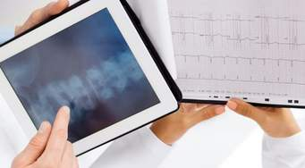
4.MEDICAL EDUCATION AND RESEARCH:
RECORDED OBSERVATIONS ARE THE BASIS FOR ALL CLINICAL RESEARCH.
FURTHER THE EDUCATION OF DOCTORS AND OTHER HEALTH PERSONNEL.
MEDICAL RECORDS SUPPLY PERTINENT DATA FOR THE USE BY PUBLIC HEALTH AUTHORITIES FOR CONTROL OF DISEASES.

Slide 8
COMPONENTS OF MEDICAL RECORD
FRONT SHEET OR IDENTIFICATION SUMMARY SHEET
CONSENT OF TREATMENT
LEGAL DOCUMENTS LUKE REFFERAL LETTER, REQUEST FOR INFORMATION ETC
DISCHARGE SUMMARY, REFERRAL SLIP
ADMISSION NOTES, CLINICAL PROGRESS NOTES, NURSES PROGRESS NOTES
OPERATION REPORT ( IF OPERATION HAS BEEN PERFORMED )
INVESTIGATION REPORTS , LIKE X RAY, PATHOLOGY , ETC
ORDERS OF TREATMENT AND MEDICATION FORMS LISTING DAILY MEDICATIONS ORDERED AND GIVEN WITH SIGNATURE OF THE DOCTOR PRESCRIBING THE TREATMENT AND THE NURSE ADMINSTERING

Slide 9
Characteristics of good medical records
1.COMPLETE :
Sufficient data to identify the patient
Justify diagnosis
Treatment
Follow up
Outcome
2.ADEQUATE :
With all necessary forms
All clinical information
3. ACCURATE
Capable of quantitative analysis

Slide 10
Flow of inpatient medical record
Four important things should be ensured
Prompt record service , for any information
Convenient and adequate accommodation
Easy availability ,retrieval of record or ready availability
Simple procedure

Slide 11
OPD.EMG,LABOUR NEWBORN
Nursing unit
Central admission office
Cencus
Checking date , time of discharge and diagnosis
ON DISCHARGE
Analysis
Assembling
Checking
Incomplete
Coding
Indexing
Reporting
Filling
Retrieval

Slide 12
FLOW CHART
REGISTRATION COUNTER CONSULTANT
IP
ADMISSION WARD MEDICAL RECORDS
INDEXING DEFICIENCY CHECK AND CODING ASSEMBLING
COMPUTER ENTRY SCANNING PERMANENT FILLING
OP

Slide 13
DIFFERENTIATION OF MEDICAL RECORD
OUT PATIENT RECORD
INPATIENT RECORD
EMERGENCY RECORD

Slide 14
OUTPATIENT RECORD
Should be located near the entrance to the OPD.
Space for desk, chair, filling racks, index cabinets
An outpatient identification ticket should have provision for
Name of the patient
Registration number
Date
The size of OPD record card recommended 9’’x6’’
Provision is made for Patient Name
Identification data
History
Physical examination finding s
Provisional diagnosis
Investigation and treatment
Diagnosis
Follow up
OPD RECORD CARD :

Slide 15
OUTPATIENT RECORD
MEDICAL RECORDS FOR THE OUTPATIENTS SHOULD ALSO BE PREPARED, PROCESSED AND STORED IN THE SAME MANNER AS THE INPATIENT’S RECORDS.
EACH INDIVIDUAL ATTENDING AN OPD IS GIVEN A REGISTRATION NUMBER AND ALL THE MEDICAL RECORDS ARE KEPT IN A FOLDER BEARING THE SAME NUMBER.
THE PATIENT IS ISSUED A TICKET/TOKEN BEARING THE REGISTRATION NUMBER.
THE INDIVIDUAL AT THE OPD RECORD ROOM SENDS THE FOLDER TO THE APPROPRIATE DEPARTMENT ON THE PRESENTATION OF TOKEN. THE FOLDER IS DEPOSITED BACK AFTER THE VISIT.

Slide 16
INPATIENT RECORD
IMPORTANT ACTIONS PERFORMED BY THE ADMITTING OFFICE ARE SUMMARIZED BELOW
a) ADMITTING OFFICE:
INITIATES PATIENT’S HOSPITALIZATION RECORDS.
ASSIGNS ADMISSION NUMBER.
PREPARES ADMISSION RECORD:
i. ADMISSION NUMBER
ii.IDENTIFYING DATA
iii.SIGNATURE OF AUTHORIZATION
• SENDS PATIENT TO NURSING UNIT.
• SENDS ADMISSION RECORD TO NURSING UNIT.
• SENDS COPY OF ADMISSION RECORD TO ADMISSION CHECK DESK.

Slide 17
B) ADMISSION CHECK DESK:
RECEIVES ADMISSION ADVICE FROM ADMITTING OFFICE. ENTERS THIS ADMISSION ON PATIENT INDEX CARD OF PREVIOUS ADMISSION.
IF NO PREVIOUS ADMISSION, MAKE NEW PATIENT INDEX CARD.
SENDS INDEX CARD TO INCOMPLETE RECORD CONTROL DESK.
SENDS RECORDS OF PREVIOUS ADMISSION TO NURSING UNIT.
PREPARES RECORD FOLDER WITH ADMISSION RECORD AND NAME AND
SENDS IT TO COMPLETE RECORDS CONTROL DESK.
MAKES ENTRIES TO ACCESSION REGISTER.
C) CENSUS DESK:
PREPARES ADMISSION LIST FROM ADMITTING OFFICE
COLLECTS DISCHARGE PATIENT RECORDS FROM NURSING UNITS DAILY.
PREPARES DISCHARGE LIST.
PREPARES CENSUS REPORTS.

Slide 18
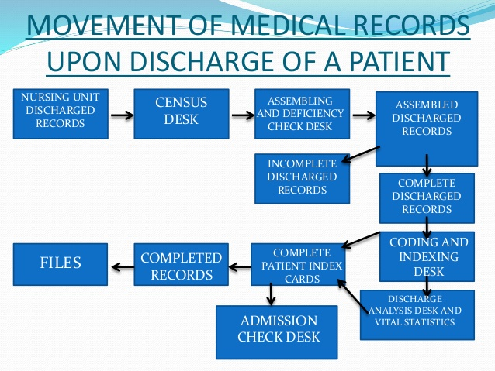

Slide 19
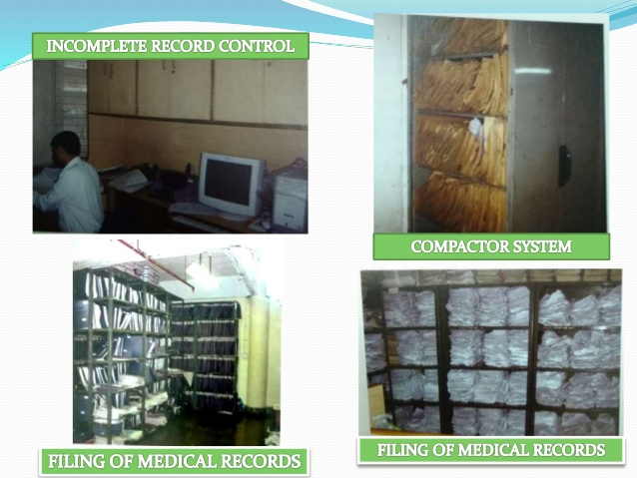

Slide 20
ASSEMBLING OF RECORDS AND DEFICIENCY CHECK
To assemble records in the following order
Face sheet, case summuary , and discharge records , history and physical examination labour record, consultation record, laboratory and other investigation reports, anaesthesia record, operation record, nurses record, temperature chart and OPD card .
Tag the case sheets, keeping in view that the MR number is not missing while tagging.
To check the complete and incomplete case sheets.
The complete case sheets be filed in the proper filing area and incomplete case sheets be sent to doctor’s room for completion .
The incomplete records should be filed unitwise.
Submission of list for incomplete records to hospital administrators periodically .

Slide 21
Coding
IN EACH MEDICAL RECORDS INTERNATIONAL CODE NUMBER IS ASSIGNED TO THE DIAGNOSIS BASED ON “INTERNATIONAL CLASSIFICATION OF DISEASE” ISSUED BY THE WORLD HEALTH ORGANISATION. 
THIS IS TO BRING ABOUT ACCURACY AND UNIFORMITY IN THE REPORTING OF THE DISEASES BY THE VARIOUS HOSPITALS.

Slide 22
Icd (international classification of diseases)
Classification of diseases and operations is one of the most important functions of the medicval record department .a well organised MRD selects one of the best suited International Classification Systems to code and index diseases and operations for the collection of morbidity and mortality information .
The international conference for the tenth revision of the INTERNATIONAL CLASSIFICATION OF DISEASES was convened by the World Health Organisation at WHO Headquarters in GENEVA from 26 th September to 2 October 1989.The conference was attended by delegates from 43 member states.

Slide 23
a) ALPHABETIC/ MASTER INDEX: INDEXING BASED ON PATIENT’S NAME SEQUENCED ALPHABETICALLY. THE PRIMARY PURPOSE OF A NAME INDEX IS TO PROVIDE ENTRY INTO THE FILING SYSTEM AND FINDING OUT MEDICAL RECORD FOR A PATIENT.
b) DISEASE INDEX: DISEASE INDEX IS A CATALOGUE OF CARDS 3” X 5” OR 5” X 8”, MAINTAINED TO FIND OUT GROUPS OF CLINICAL RECORDS OF PATIENTS HAVING THE SAME DIAGNOSIS. BESIDES PATIENT’S IDENTIFICATION DATA, AGE, GENDER, RESULT OF TREATMENT AND COMPLICATION MAY ALSO BE MENTIONED.
c) OPERATION INDEX: IT IS A CATALOGUE CONTAINING THE DETAILS OF PATIENTS WHO HAVE UNDERGONE THE OPERATIONS.
d) PHYSICIAN’S INDEX: CATALOGUE CONTAINING THE DETAILS OF ALL PATIENTS TREATED BY PARTICULAR PHYSICIANS. ANALYSIS OF SUCH RECORDS MAY BE UTILIZED FOR EVALUATING THE PERFORMANCE OF A PHYSICIAN.
e) UNIT INDEX: DETAILS OF ALL THE PATIENTS TREATED IN A PARTICULAR UNIT ARE INDEXED. THESE RECORDS MAY ULTIMATELY BE UTILIZED TO EVALUATE THE PERFORMANCE OF A PARTICULAR UNIT.

Slide 24
Indexing
A physician or a medical staff can use this index for the following purpose.
Review cases of disease to provide the management a scenario of current health problem .
Compose data on diseases in order to prepare scientific papers .
Procure data on the utilization of hospital facilities and increase the needs such as equipment and beds.
Evaluate the quality of care in the hospital.
Providing patient care data for committees.
Data on the medical practice in the hospital.
Data on drug trail for research

Slide 25
Patient index
8.Sort out the cards in the alphabetical order
9.File in the patient index cabinet strictly in alphabetical order.
10.Take help of this index if the MR number has to be found out only by name. Sometimes the patient does not remember the date of admission in the hospital .
INDEXING ( DIAGNOSTIC)
Indexing of all cases with multiple code numbers.
Put the year and code number on the top of the card used, the first card as A1, back A2 so on.
Make entries of MR numbers , age and sex, complication unit, duration of stay .
Compilation of provisional diagnosis in code numbers , later on monthly basis .

Slide 26
STORAGE AND RETRIEVAL
STORAGE: THE FOLLOWING FACTORS ARE CONSIDERED FOR AN EFFECTIVE FILING SYSTEM:
a) COMPACTNESS TO REDUCE PHYSICAL EFFORT AND COST OF STORAGE SPACE.
b) ACCESSIBILITY FOR SPEEDY LOCATION AND IDENTIFICATION.
c) SIMPLICITY FOR UNDERSTANDING OF ALL CONCERNED.
d) ECONOMICAL BOTH IN THE COST OF INSTALLATION AND OPERATION
e) ELASTICITY TO EXPAND ACCORDING TO FUTURE REQUIREMENT.
f) TRACER SYSTEM FOR DOCUMENT IN CIRCULATION.

Slide 27
SYSTEMS OF FILING
DECENTRALIZED SYSTEM
UNDER THIS SYSTEM, INPATIENT AND OUTPATIENT DEPARTMENTS HAVE THEIR OWN INDIVIDUAL RECORDS AND FILE THEM INDEPENDENTLY WITHIN THEIR DEPARTMENTS.
THIS SYSTEM IS LABOUR INTENSIVE AND THE OPERATING COST ARE HIGHER.
CENTRALIZED SYSTEM
IN THE CENTRALIZED SYSTEM, MEDICAL RECORDS ARE FILED CENTRALLY IN THE MEDICAL RECORD DEPARTMENT. THIS SYSTEM IS MORE EFFICIENT, PROVIDES BETTER CONTROL AND IS FOLLOWED IN MOST HOSPITALS.

Slide 28
METHODS OF FILING
NUMERICAL METHOD
ALPHABETICAL METHOD
CHRONOLOGICAL ORDER
TERMINAL DIGIT SYSTEM
MID DIGIT SYSTEM

Slide 29
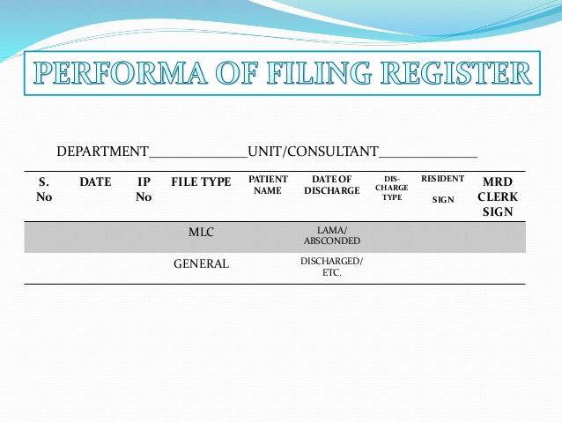

Slide 30
FILING PROCEDURES
TYPES OF FILES-
USEFUL TO USE FILES OF DIFFERENT COLOURS FOR DIFFERENT YEARS FOR EASY RETRIEVAL
AND IDENTIFICATION.
FILING :
THREE TYPES OF FILING PROCEDURE IN USE
VERTICAL-
SUSPENDED
HORIZONTAL

Slide 31
MICROFILMING OF MEDICAL RECORDS
1.IN LARGE TEACHING HOSPITALS DUE TO CONSTRAINTS OF SPACE MICROFILMING IS RESORTED TO.
2.ADVANTAGES OF MICROFILMING :-
SAVING OF SPACE BY 90%.
EASY ACCESSIBILITY.  PROTECTION.
ELIMINATION OF MISFIRING.
SAVING OF TIME & MANPOWER. 
SPECIAL EQUIPMENT REQUIRED INCLUDES MICROFILMING
CAMERA,
PROCESSORS
, VIEWING MACHINES,
DUPLICATING & XEROX MACHINES,
MICROFILMING ROLLS,
FIXER & DEVELOPER AND
MICROFILMING TECHNICIANS.

Slide 32
COMPUTERISATION OF MRD RECORDS
TECH ADVANCEMENTS & DECREASING COST OF COMPUTERISATION HAVE REVOLUTIONISED THE MED RECORD SYSTEM.
POSSIBLE TO STORE TEXT & ALL TYPES OF IMAGES VIZ X-RAYS, CAT SCAN, MRI.
BY NETWORKING SYSTEM ACCESS CAN BE PROVIDED TO DRs, NURSES, TECHNICIANS & ADMINISTRATOR WHILE MAINTAINING CONFIDENTIALITY.

Slide 33
RETREIVAL OF MEDICAL RECORDS
USUALLY REQD FOR
FOLLOW UP OF PATIENTS.
ADMISSION TO WARD/ CASUALTY FOR OBSERVATION.
RESEARCH WORKERS FOR ACADEMIC PURPOSES.
MEDICAL REIMBURSEMENT.
PRODUCING IN COURT OF LAW.

Slide 34
REPORTS AND RETURNS
BASIC PURPOSE OF REPORTS ARE:
EVALUATING THE QUALITY OF CARE.
LOCATING THE DEFI IN :
a) MEANS – STAFF, PHYSICAL FACILITIES, EQPT INCL PLANTS & MACHINES. 
b) METHODS – OPERATING POLICIES & PROCEDURES.
C)END RESULT- OUTCOME OF BENEFITS DERIVED BY THE COMMUNITY FROM THE HOSP.
EFFECTIVENESSOF HOSP ADMINISTRATION. PREVENION OF DISEASES

Slide 35
TYPES OF REPORTS
TYPES OF REPORTS & FREQUENCY WILL VARY WITH TYPE OF HOSPITAL & ADM REQMTS.
REPORTS GENERATED DAILY, WEEKLY, FORTNIGHTLY, MONTHLY, QUARTERLY, SIX MONTHLY OR ANNUALLY DEPENDING ON REQMT .
REPORTS GENERALLY PERTAIN TO :
VITAL STATS.
ADT(ADMISION, DISCHARGEAND TRANSFER ANALYSIS.
GENERAL HEALTH STATS.

